Slide 1
430.211 Programming Methodology (프로그래밍 방법론)
Taesup Moon
Department of Electrical and Computer Engineering
Seoul National University

Slide 2
Outline
Chapter 2: Flow of Control

Slide 3
Chapter 2: Flow of Control : What are we learning?
Boolean Expressions
Building, Evaluating & Precedence Rules
Branching Mechanisms
if-else
switch
Nesting if-else
Loops
while, do-while, for
Nesting loops
Introduction to File Input
Choice of two alternate statements based on condition expression
Example: if (hrs > 40) grossPay = rate*40 + 1.5*rate*(hrs-40); else grossPay = rate*hrs;

Slide 4
Branching Mechanisms : Example
if-else statements
Choice of two alternate statements based on condition expression
Example: if (hrs > 40) grossPay = rate*40 + 1.5*rate*(hrs-40); else grossPay = rate*hrs;
Most branching mechanisms are controlled by Boolean expressions
Check whether
True or False

Slide 5


Boolean Expressions
Logical operators
Logical AND (&&)
Logical OR (||)

Slide 6
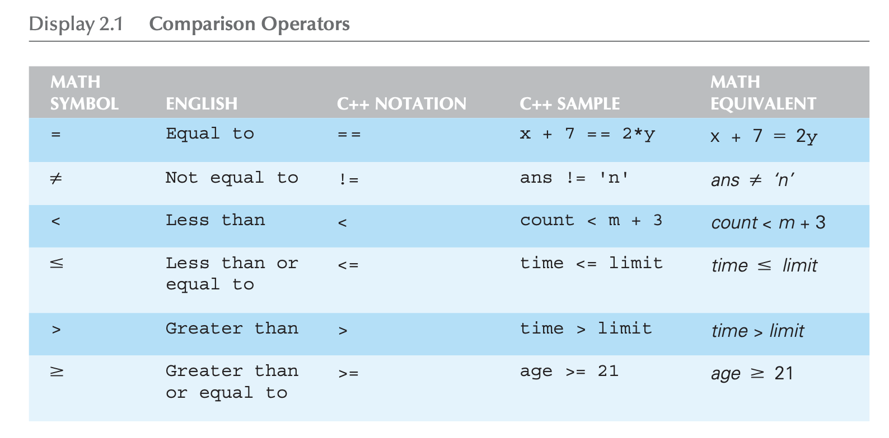
Boolean Expressions
Comparison operators

Slide 7

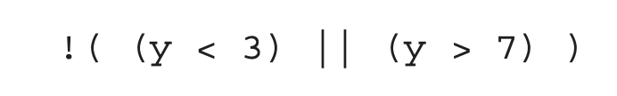
Evaluating Boolean Expressions
Variable type, bool
Can store either of the values True or False
Boolean expression can be evaluated in the same way that an arithmetic expression is evaluated
E.g., let y=8. What is
?

Slide 8
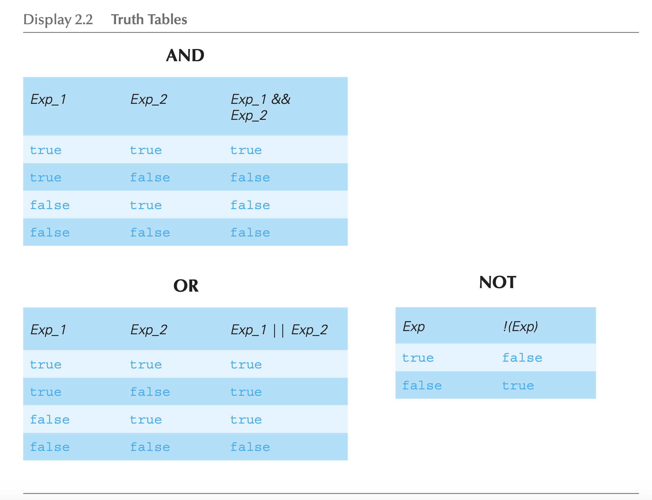
Evaluating Boolean Expressions: : Truth Tables

Slide 9
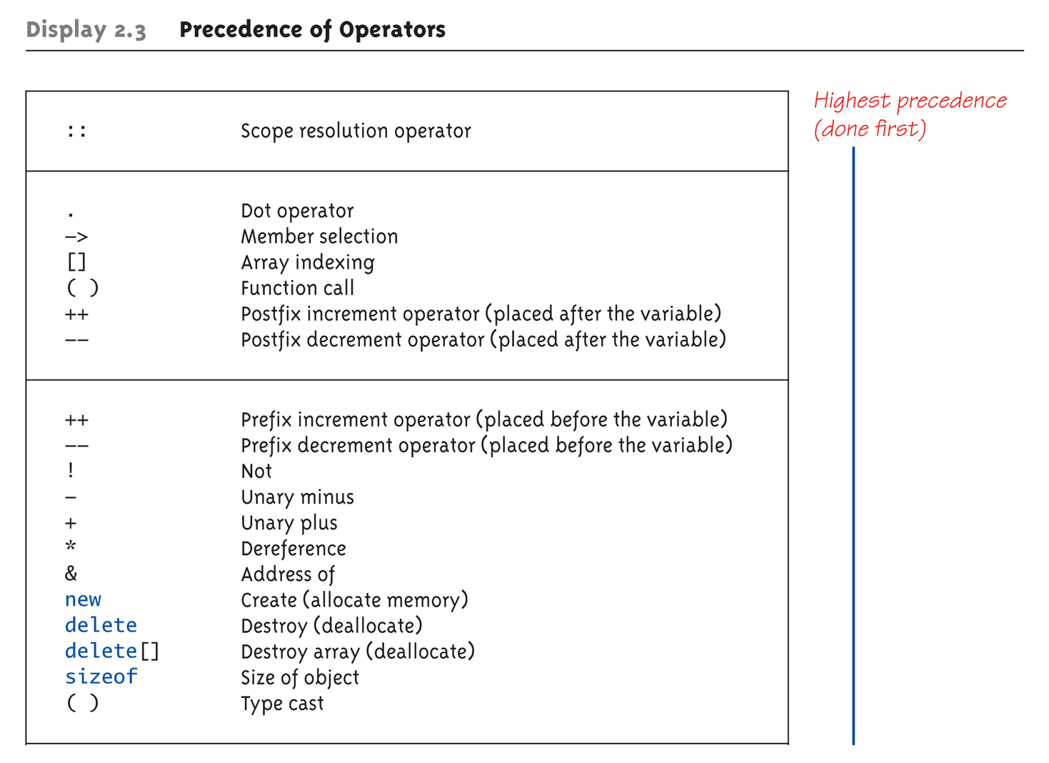
Evaluating Boolean Expressions: : Precedence Rules (1 of 4)

Slide 10
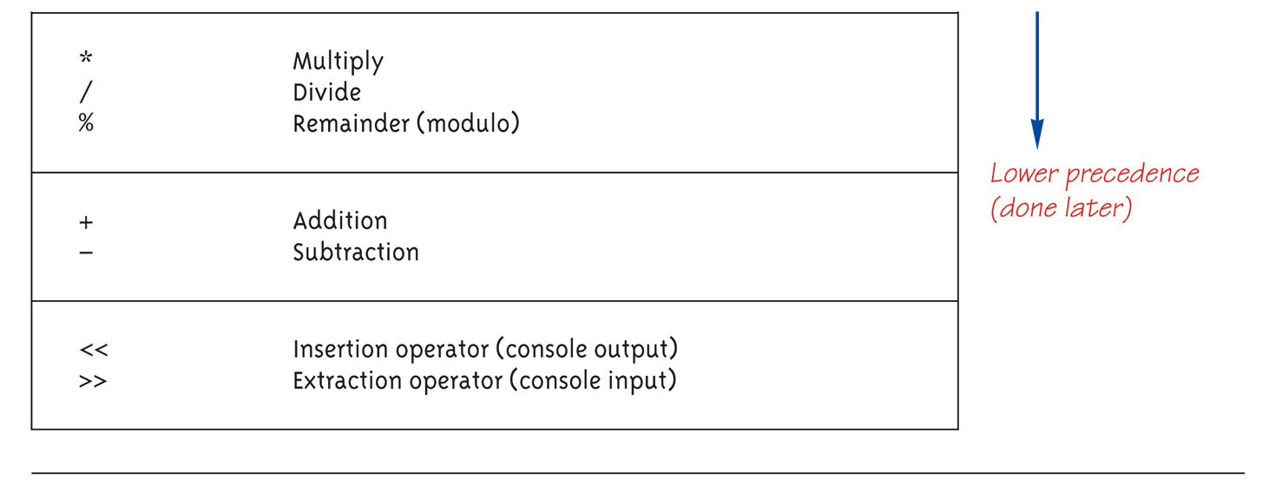
Evaluating Boolean Expressions: : Precedence Rules (2 of 4)

Slide 11
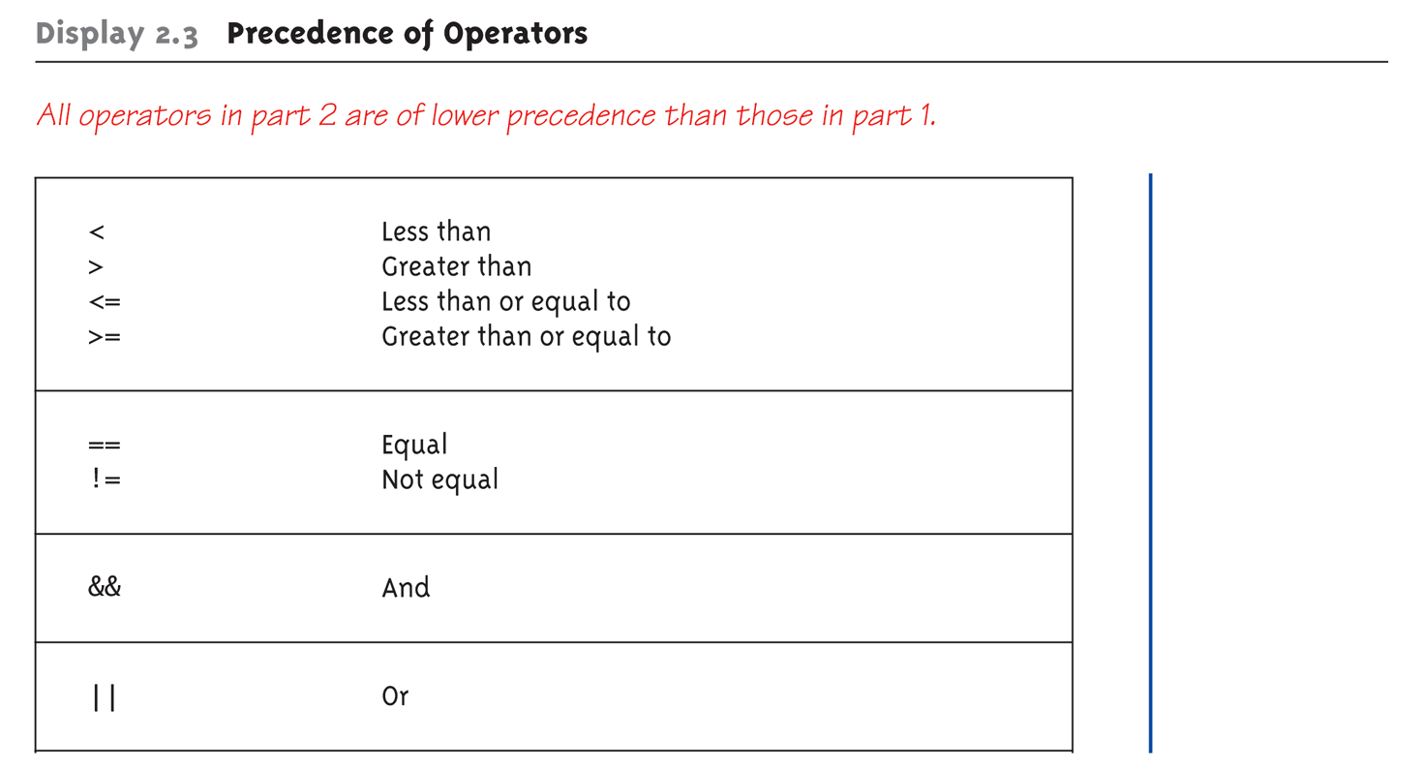
Evaluating Boolean Expressions: : Precedence Rules (3 of 4)

Slide 12
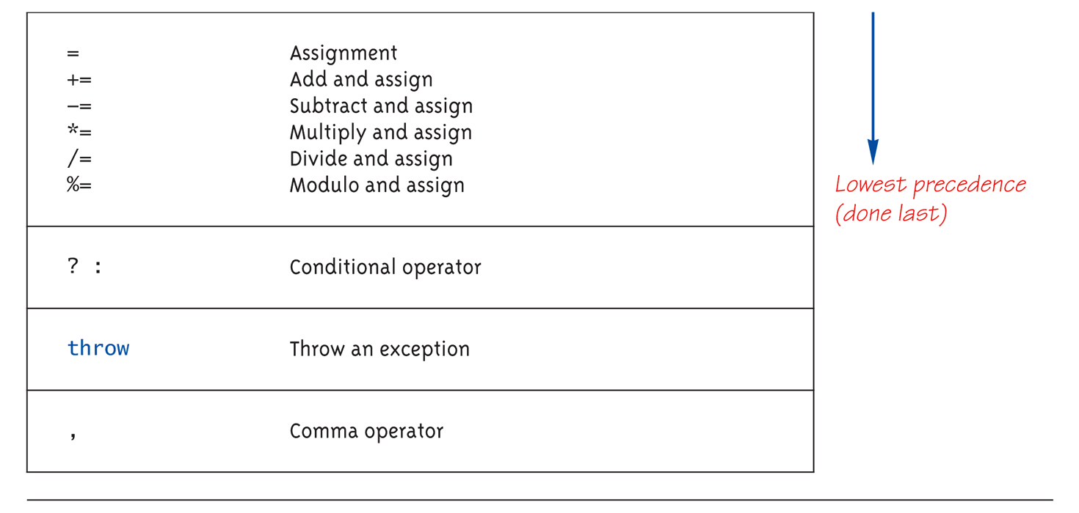
Evaluating Boolean Expressions: : Precedence Rules (4 of 4)

Slide 13
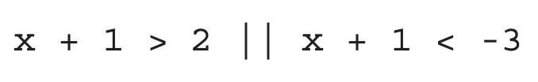
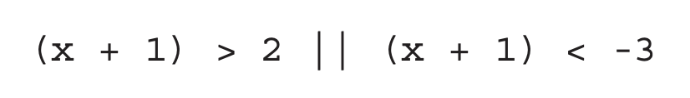
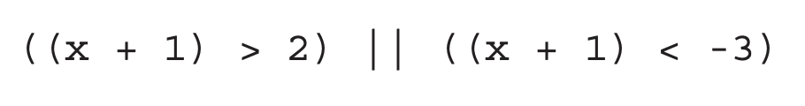
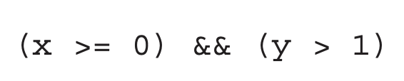
Evaluating Boolean Expressions : Examples
How to evaluate the following?
Roughly, arithmetic done before the comparison & logical
Followings are all equivalent
Short-circuit evaluation
Evaluation stops when the result is already decided
E.g.,
if x<0, the expression is definitely False since (x>=0) is False → evaluation stops!

Slide 14
Evaluating Boolean Expressions : Examples
Short-circuit evaluation
Be careful with increment operators!
E.g., (x > 1) && (y++)
If x>1 is False, y++ is not executed!
Avoid using ++ or – operator within && or ||
Integers as Boolean values
All non-zero values → True
Zero value → False

Slide 15
Branching Mechanism : if-else statement syntax
Formal syntax: if (<boolean_expression>) <yes_statement> else <no_statement>
Note each alternative is only ONE statement.
To have multiple statements execute in either branch → Use compound statement

Slide 16
if-else Branching Mechanism : Compound/Block statements
Must use compound statement { } for multiple statements
Also called as a "block" statement
Can be used even if there is just one statement
Enhances readability

Slide 17
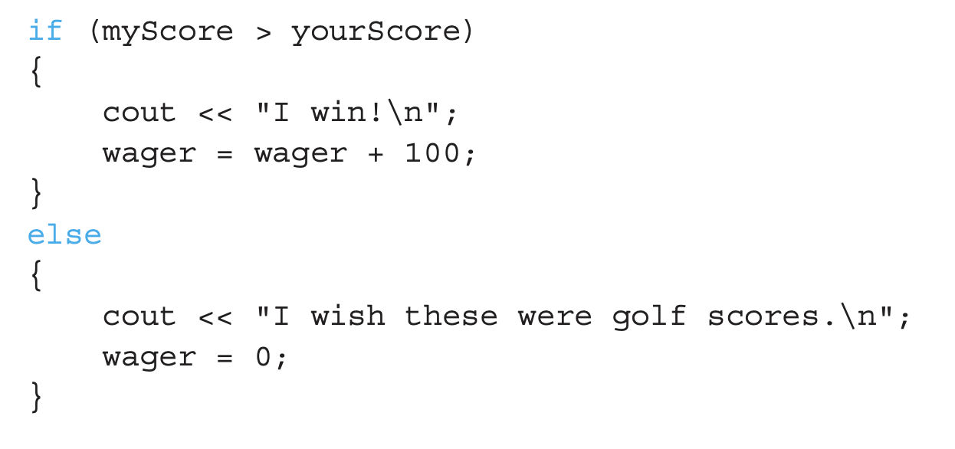
if-else Branching Mechanism : Compound/Block statements in Action
Note indenting in this example:

Slide 18
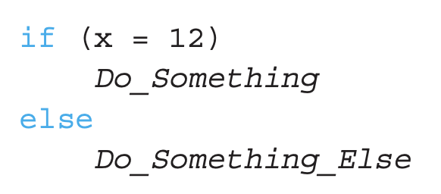
Common Pitfalls! : if-else
Using = in place of ==
The former means "assignment" (=)
The latter means "equality" (==)
They have VERY different meanings in C++!
E.g., :
Wrong!

Slide 19
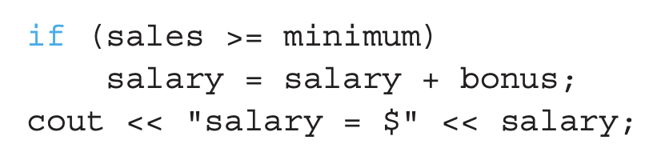
if-else Branching Mechanism : Omitting the else
else clause is optional
If, in the false branch, you want "nothing" to happen, leave it empty
E.g.,
If False, nothing happens
Execution continues with cout statement

Slide 20
if-else Branching Mechanism : Nested Statements
if-else statements contain smaller statements
Compound or simple statements (we’ve seen)
Can also contain any statement, including another if-else statement!
Example: if (speed > 110) if (speed > 130) cout << "You’re really speeding!"; else cout << "You’re speeding.";
Note proper indenting!

Slide 21
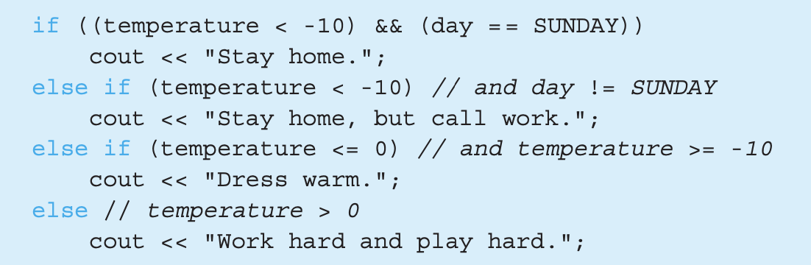
if-else Branching Mechanism : Multiway if-else
Multiway if-else statement is just another variation
In order to prevent excessive indentation
E.g.,

Slide 22
The switch Statement
Controls multiple branches
Can do the same thing with if-else, but sometimes switch is more convenient
Uses a controlling expression which returns either
Bool
Enum (will be discussed later)
Integer type
Character

Slide 23
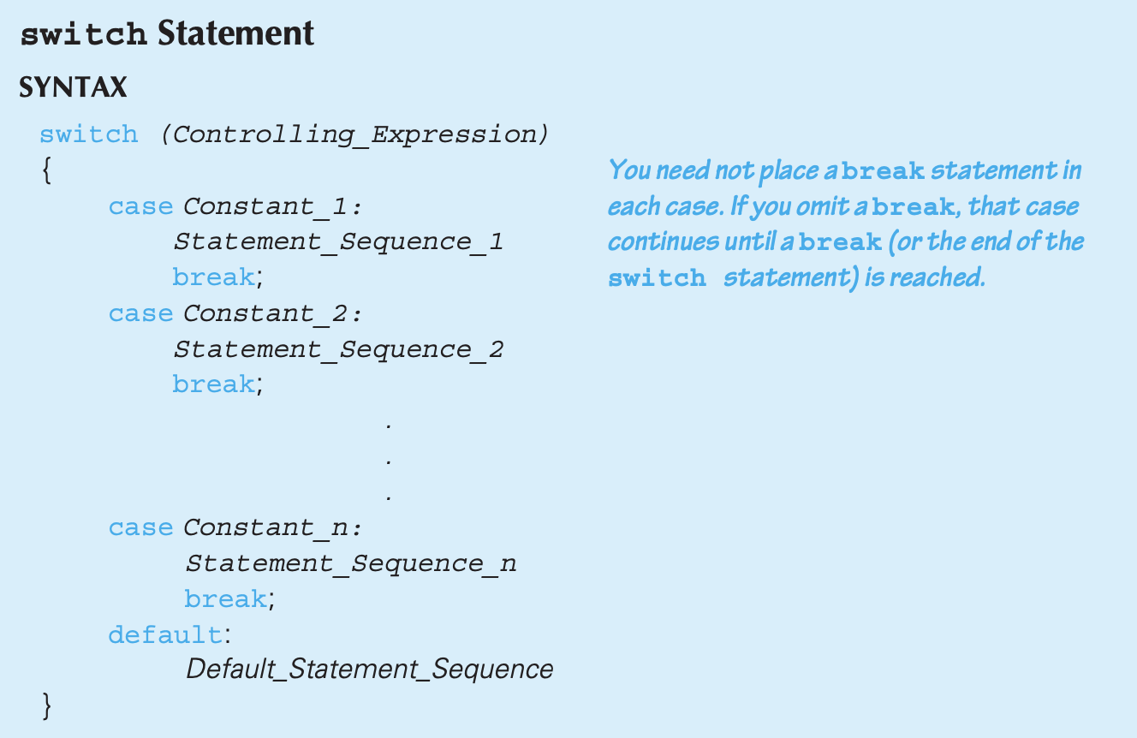
The switch statement syntax

Slide 24
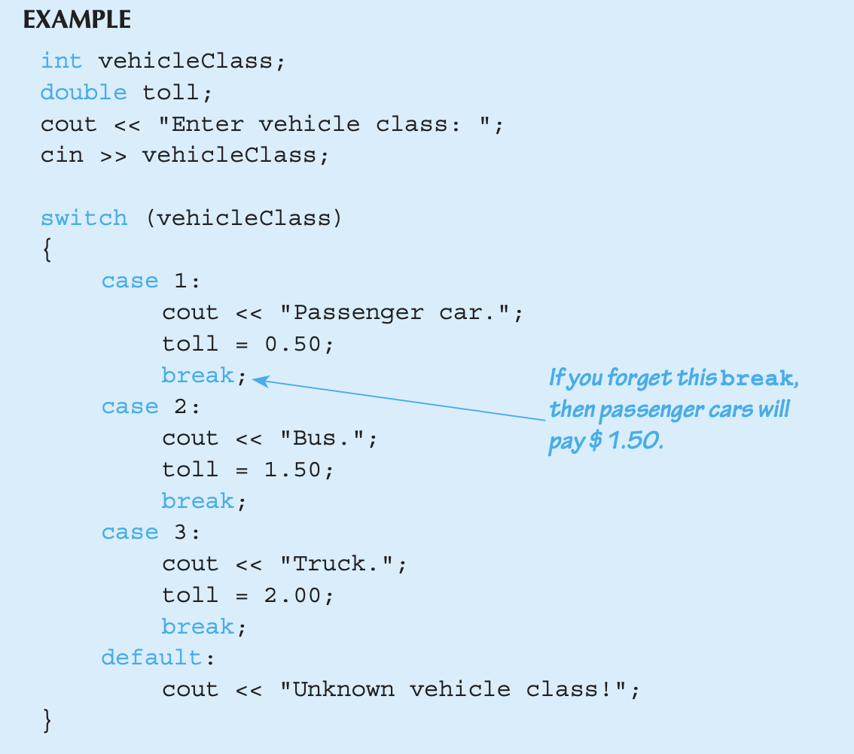
The switch statement syntax

Slide 25
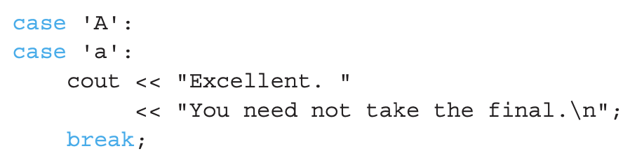
The switch statement syntax
break
switch ends when break is encountered or the end is reached
We can have two cases run the same code
Since no break statement in the first case
default : when no cases are matched
Good to include (not mandatory)

Slide 26
Common pitfalls / tips! : switch
Forgetting the break
No compiler error
Execution simply "falls thru" other cases until reaching break;
if-else is more versatile, but sometimes switch is more handy
E.g., implementing MENUs
Provides clearer "big-picture" view
Shows menu structure effectively
Each branch is one menu choice

Slide 27
switch Menu example
switch (response) { case 1: // Execute menu option 1 break; case 2: // Execute menu option 2 break; case 3: // Execute menu option 3 break; default: cout << "Please enter valid response."; }

Slide 28
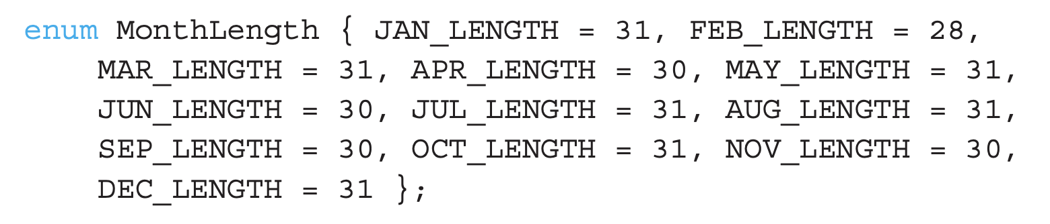
enumeration types
enumeration type
Defined by a list of constants of type int
E.g., following defines constants for each month
When no values are assigned, consecutive values starting from 0 are assigned
Equivalent!
??

Slide 29
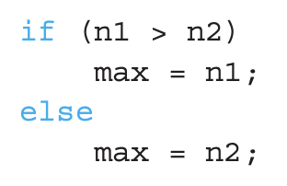

Conditional Operator
Also called "ternary operator"
Allows embedded conditional in expression
Essentially "shorthand if-else" operator
Example:
Can be written as :
"?" and ":" form this "ternary" operator

Slide 30
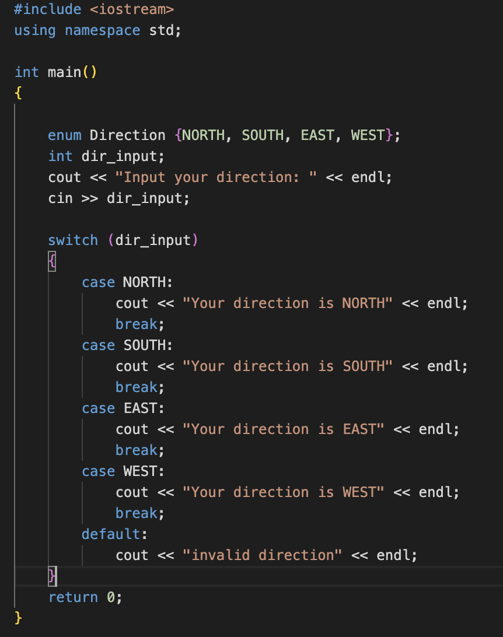
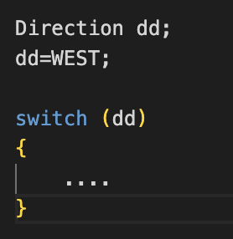
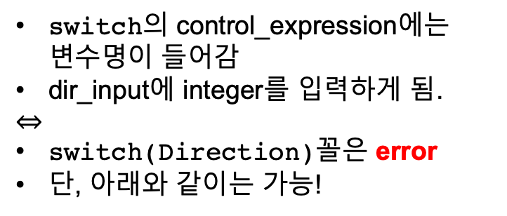
switch / enum 예시
switch의 control_expression에는 변수명이 들어감
dir_input에 integer를 입력하게 됨.
$$⇔$$
switch(Direction)꼴은 error
단, 아래와 같이는 가능!

Slide 31
Three Types of Loops in C++
while
Most flexible
No ”restrictions”
do-while
Least flexible
Always executes loop body at least once
for
Natural “counting” loop

Slide 32
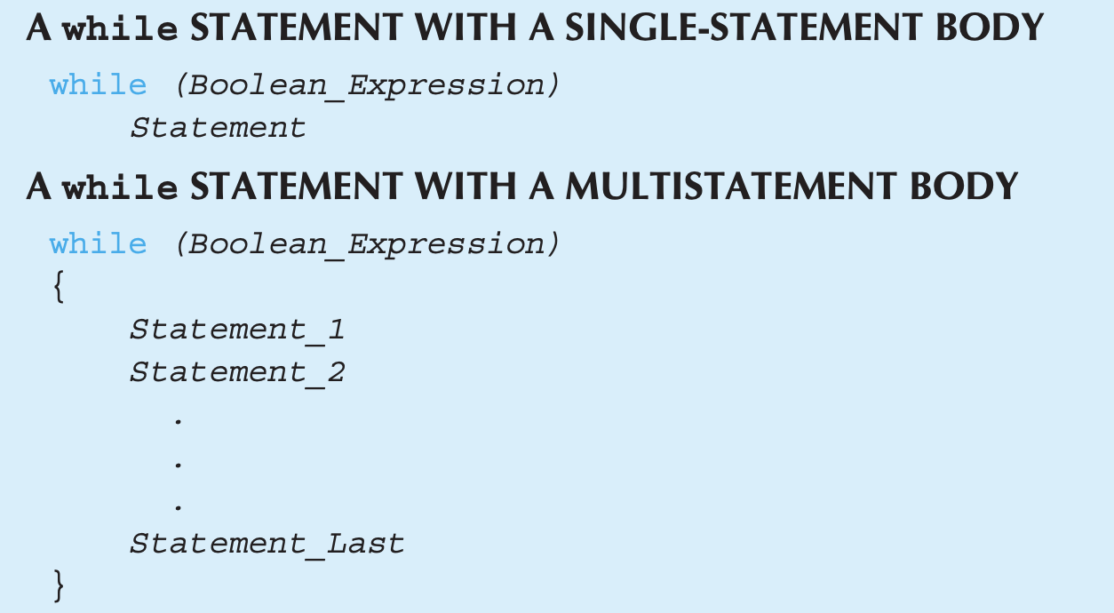
while Loops Syntax

Slide 33
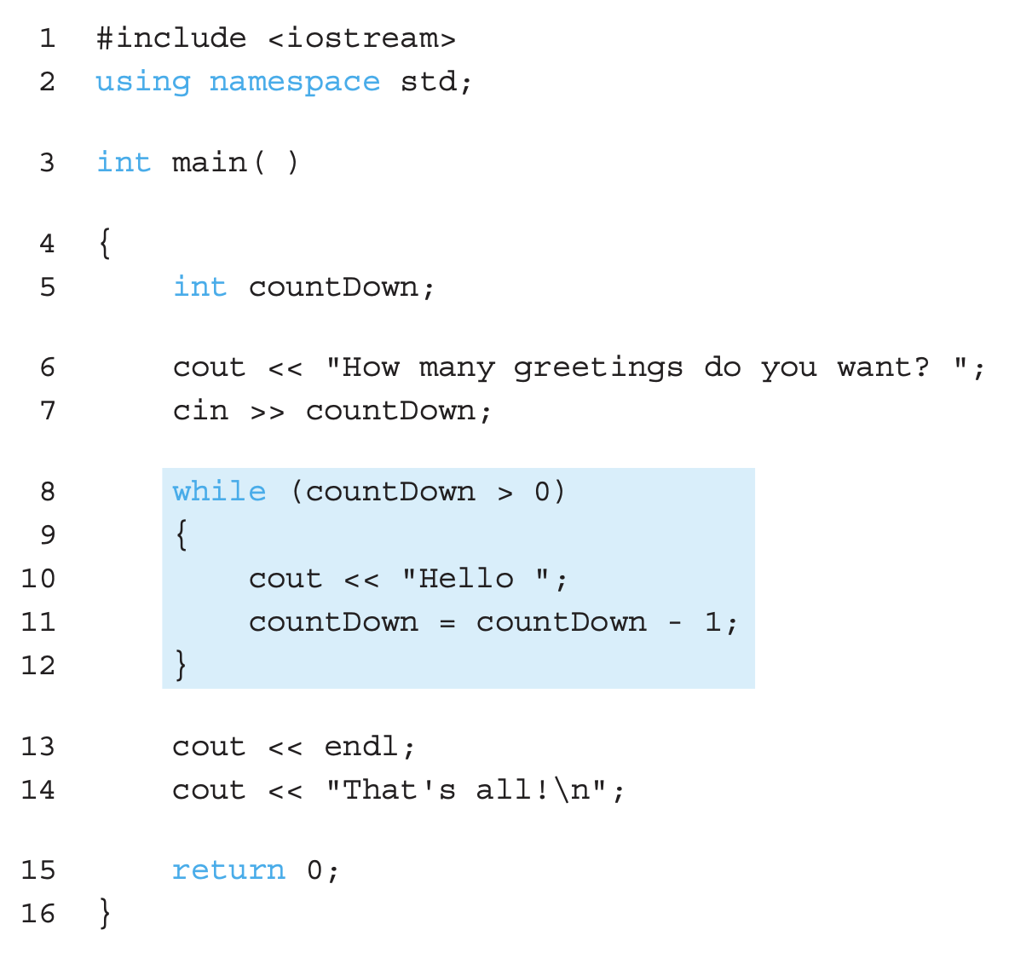
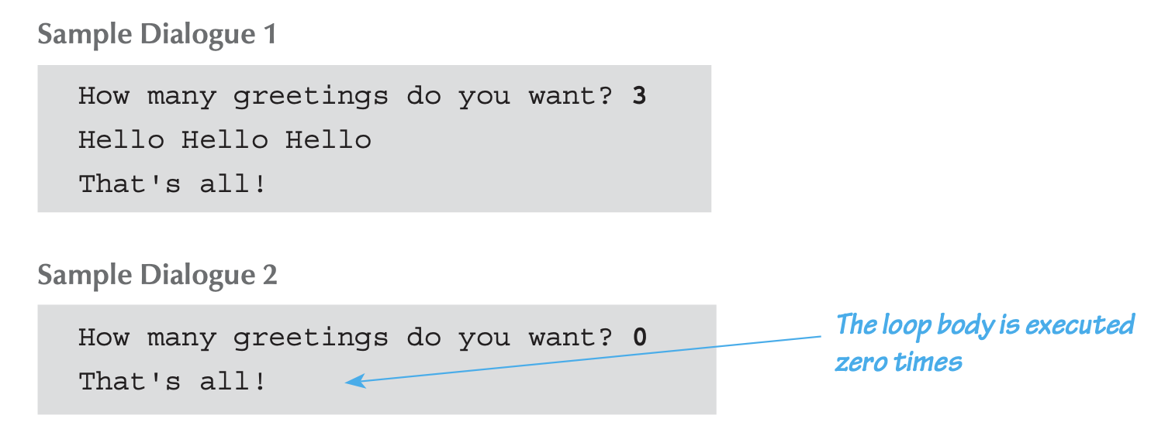
while Loop Example

Slide 34
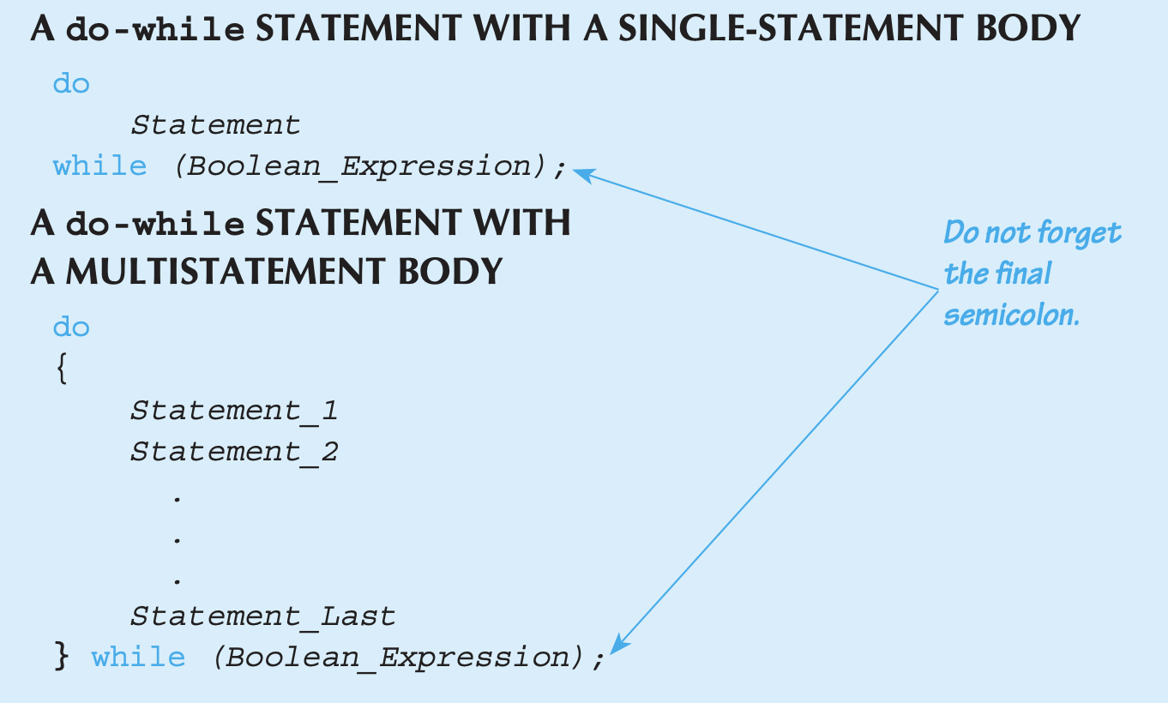
do-while Loops Syntax

Slide 35
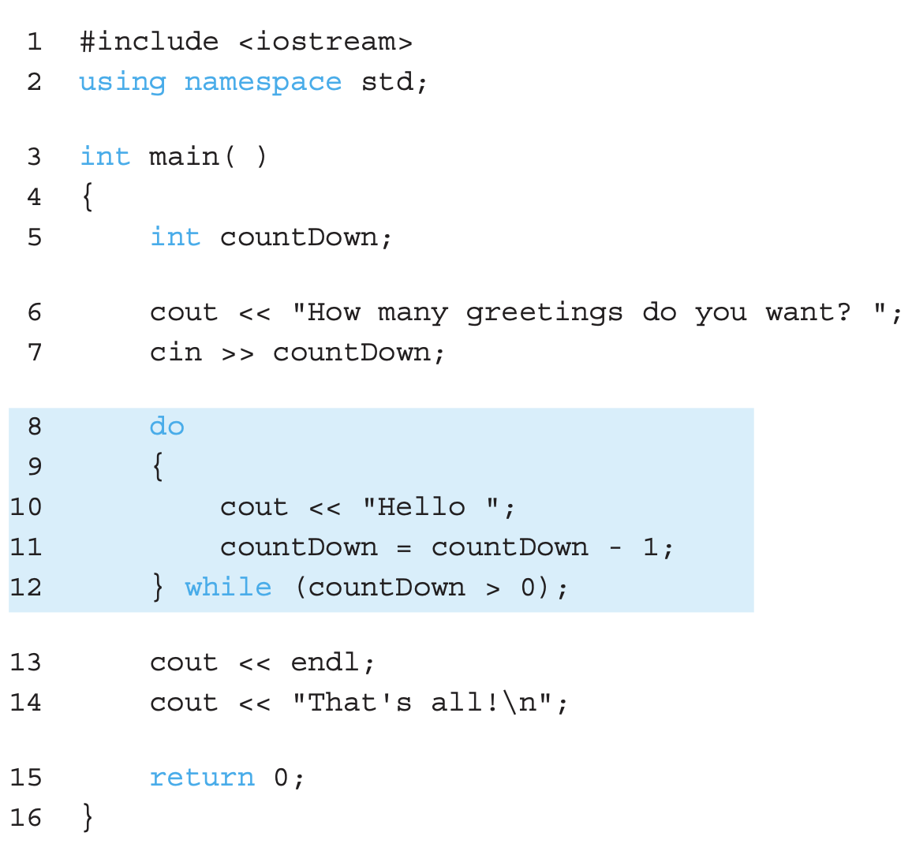
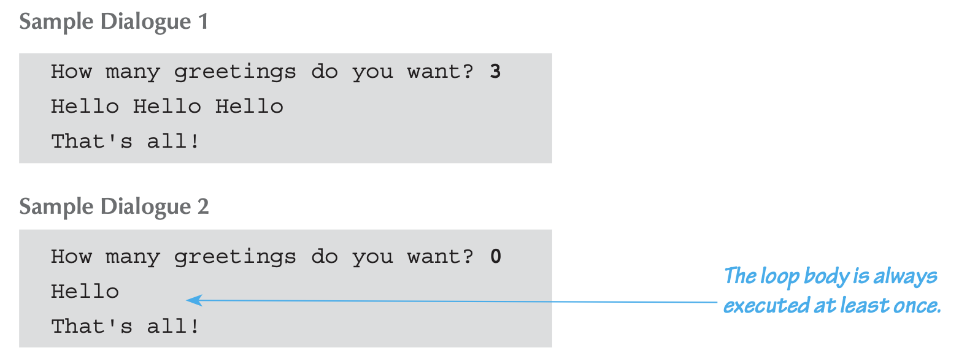
do-while Loop Example

Slide 36
while vs. do-while
Very similar, but a subtle difference
One difference regarding checking Boolean expression
while : checks BEFORE the body is executed
do-while: checked AFTER the body is executed
What’s the point of iterating zero times (as in while)?
Ex1) when summing the numbers in a list, it can be empty!
A checkbook balancing program
while is more common, due to its "flexibility"

Slide 37
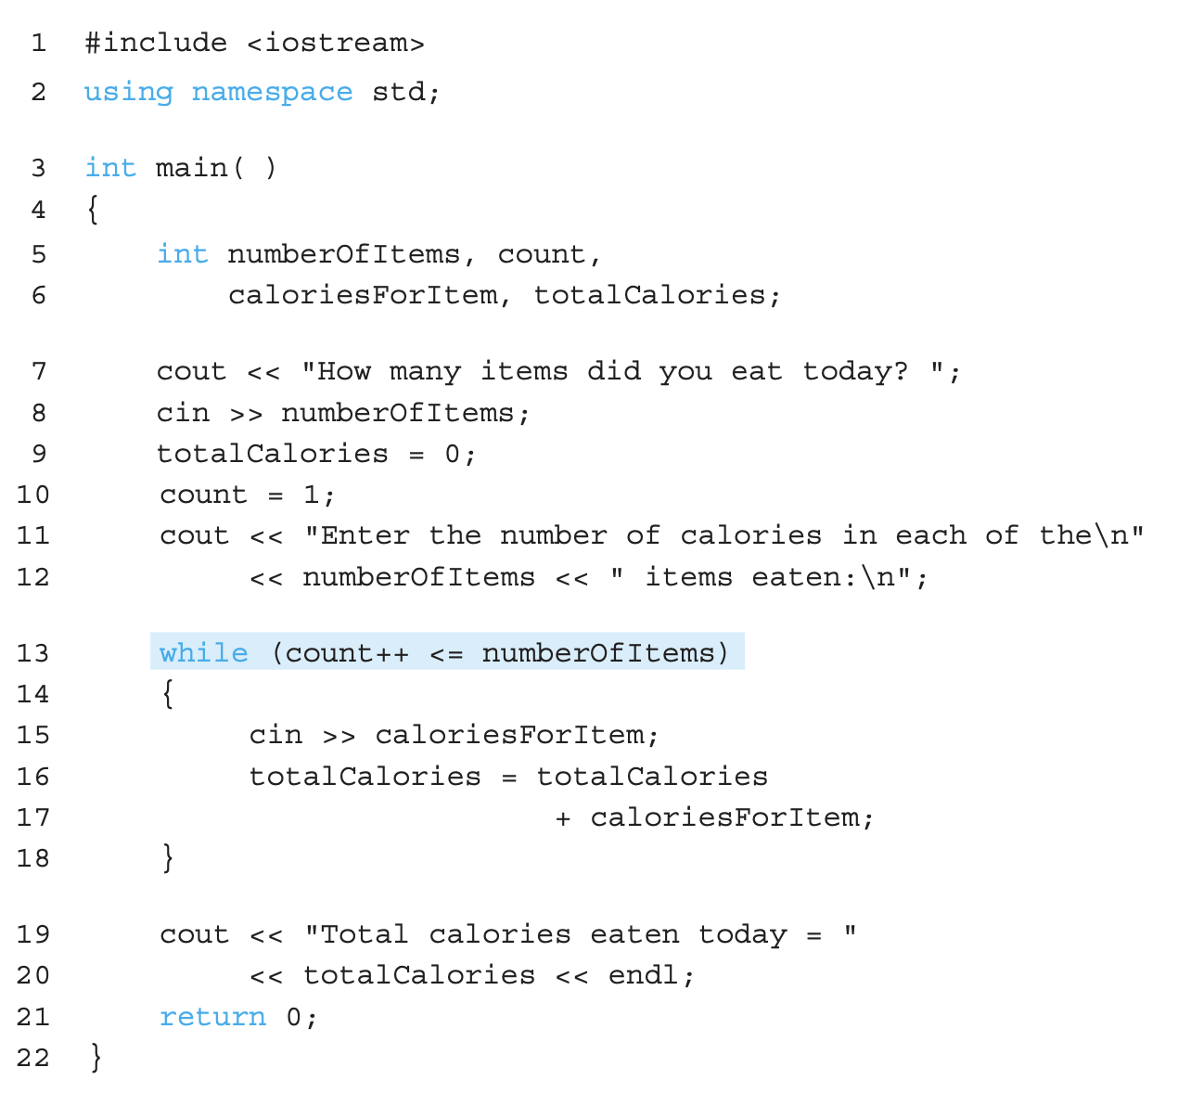
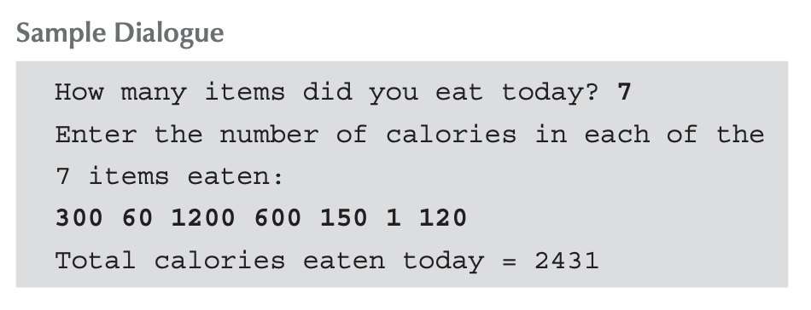
Increment/decrement operators
Generally discouraged to use in the Boolean expressions → But, if done with cares, it can work out.
What is the value of count after printing the totalCalories?

Slide 38
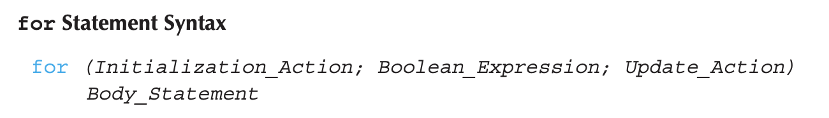
for Loop Syntax
A general looping mechanism that can do anything that a while can do
Like if-else,Body_Statement can be a block statement
The third Update_Action is optional
Often used to step through an array (Ch.5)
No semicolon!

Slide 39
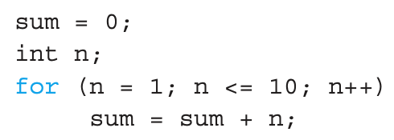

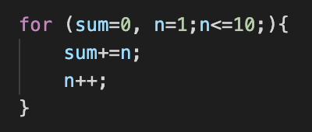
for Loop Syntax
No semicolon!
Followings are all equivalent! (comma operator allows multiple actions!)

Slide 40
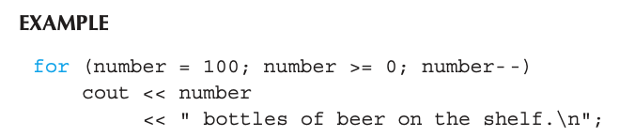
for Loop Syntax
How many times does the loop body executes?
101 times
Initialization, loop condition, update all “built in”
Execution order: Initialization → check condition → loop body → update action → check condition → loop body → …
Q) Is it possible to have a for loop whose body is executed zero times?

Slide 41
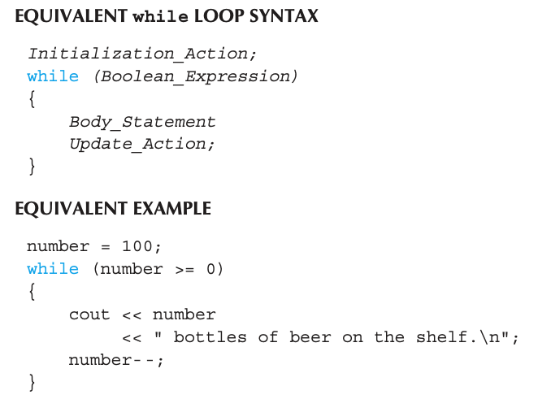
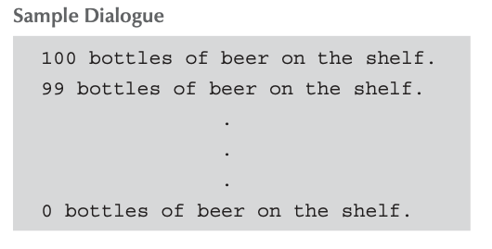
for Loop Syntax

Slide 42
Loop Issues
Loop’s condition expression can be ANY Boolean expression
Examples:
while (count<3 && done!=0) { // Do something }
for (index=0;index<10 && entry!=-99) //update is omitted { // Do something }

Slide 43

Loop Pitfalls : Misplaced ;
Watch the misplaced ; (semicolon)
Example:
Notice the ‘;’ after the for loop
; also is an empty statement!
It will print ‘Hello’ only once!
Nothing happens for
Similar issue exists for the while loop

Slide 44
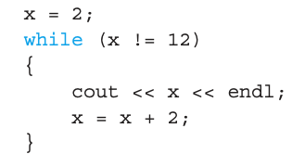

Loop Pitfalls : Infinite Loops
Loop condition must evaluate to False at some iteration through the loop. If not, we have an infinite loop!
Above is fine. But, if the initialization is x=1,it never ends!
A safer choice: replace the Boolean expression with
Infinite loops can be desirable sometimes
e.g., airline reservation system

Slide 45
The break and continue statements
Flow of Control
Recall how loops provide "graceful" and clear flow of control in and out
In RARE instances, we can alter natural flow
break;
Ends the entire loop
continue;
Ends the current iteration of the loop body
These statements violate natural flow
Only used when absolutely necessary!

Slide 46
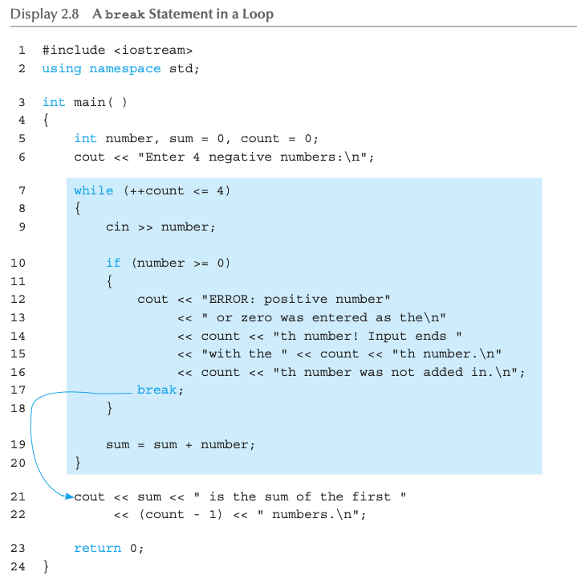
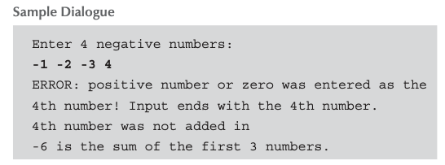
The break and continue statements

Slide 47
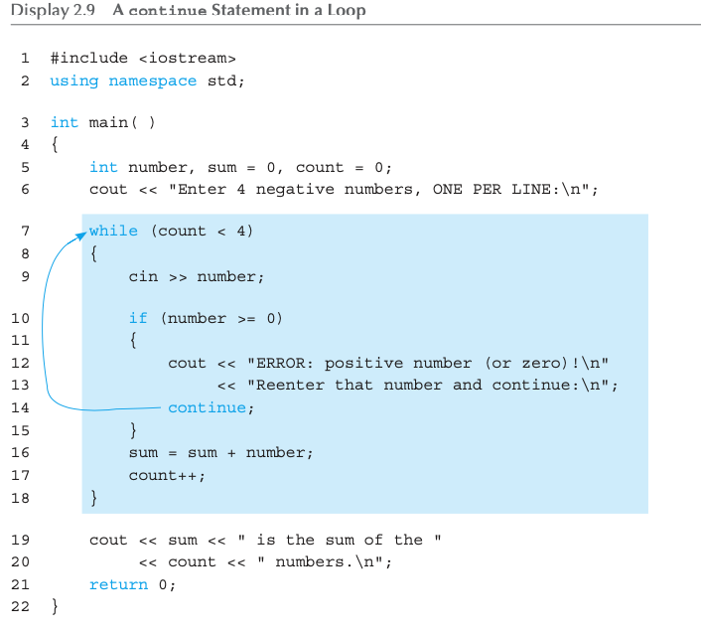
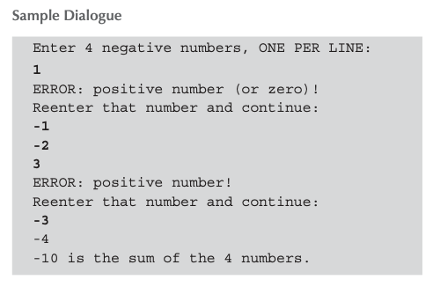
The break and continue statements
Notice also the difference in the update statements!

Slide 48
Nested Loops
ANY valid C++ statements can be inside body of loop
This includes additional loop statements!
Called "nested loops"
Requires careful indenting: for (outer=0; outer<5; outer++) for (inner=7; inner>2; inner--) cout << outer << inner;
Notice no { } since each body is one statement

Slide 49
Introduction to File Input
We can use cin to read from a file in a manner very similar to reading from the keyboard
Only an intro is given here, more details in Ch. 12
Just enough so you can read from text files and process larger amounts of data that would be too much work to type in

Slide 50
Opening a Text File
Add at the top
#include <fstream>
using namespace std
Then, declare an input stream just as you would declare any other variable
ifstream inputStream;
Next, connect the inputStream variable to a text file on the disk
inputStream.open(“filename.txt");
“filename.txt” denotes the the file is in the same directory as the code. (Need a pathname if the file is in other directory.) )

Slide 51
Reading from a Text File
Use
inputStream >> var;
The result is the same as using cin >> var except the input is coming from the text file and not the keyboard
Reading a string is done UP TO a whitespace character
When done with the file close it with
inputStream.close();
Releases any resources that have been allocated in association with the file

Slide 52
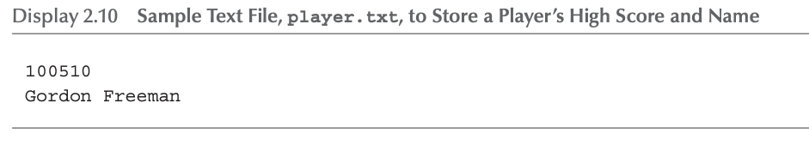
File Input Example (1 of 2)
Consider a text file named player.txt

Slide 53
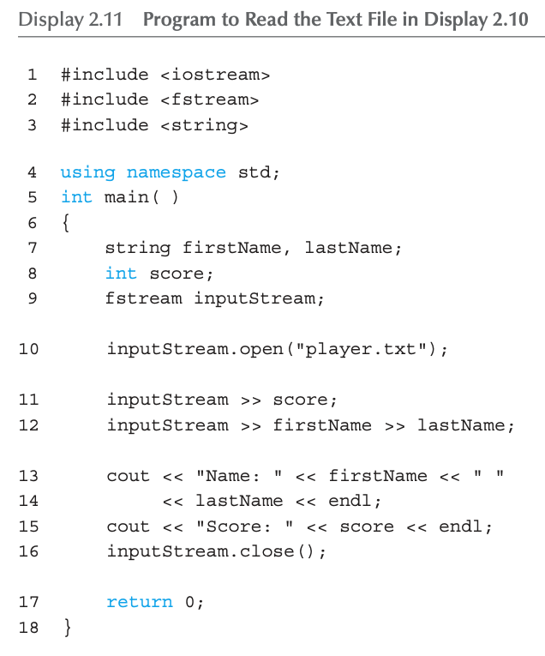
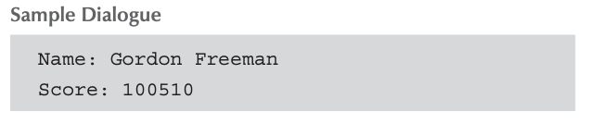
File Input Example (2 of 2)
Consider a text file named player.txt
ifstream: input only
ofstream: output only
fstream: both input/output

Slide 54
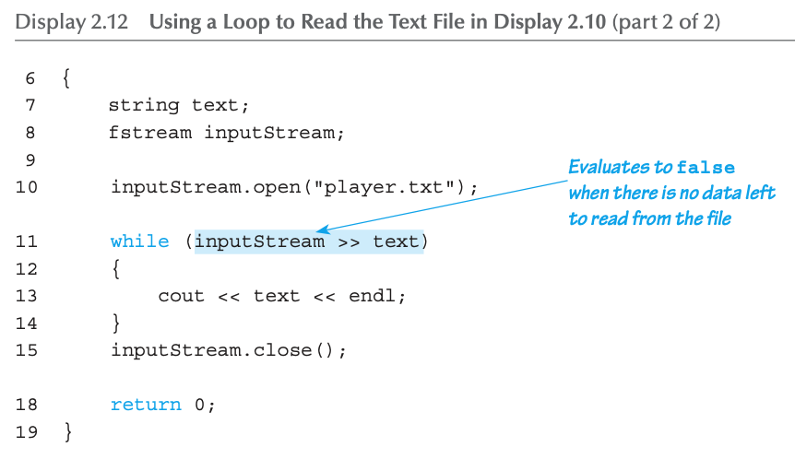
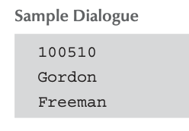
Using a Loop to Read the Text File Input
Consider a text file named player.txt
Performs two actions
A read action
Checking a Boolean result

Slide 55
Summary 1
Boolean expressions
Similar to arithmetic → results in True or False
C++ branching statements
if-else, switch
switch statement great for menus
C++ loop statements
while
do-while
for

Slide 56
Summary 2
do-while loops
Always execute their loop body at least once
for loop
A natural "counting" loop
Loops can be exited early
break statement
continue statement
Usage restricted for style purposes
Reading from a text file is similar to reading from cin

Slide 57
Thank you!
Web: http://mindlab-snu.github.io
E-mail: tsmoon@snu.ac.kr

